Slide 1
CMSC201 Computer Science I for Majors Lecture 22 – Dictionaries
Prof. Katherine Gibson
Based on slides from http://www.ou.edu/memorylab/python/Lsn15_Tuples.ppt

Slide 2
Last Class We Covered
Python’s tuple data structure
Tuples in functions (and as return values)
Basic tuples operations, including…
Creation
Conversion
Repetition
Slicing
Traversing

Slide 3
Any Questions from Last Time?

Slide 4
Tuple Practice
def min_max(t):
"""Returns the smallest and largest
elements of a sequence as a tuple"""
return (min(t), max(t))
seq = [64, 71, 42, 73, 85, 33]
minOutput, maxOutput = min_max(seq)
Print(minOutput, maxOutput)
string = 'We are the Knights who say... NI.'
print (min_max(string))
What does this output?
(33, 85)
(' ', 'y')

Slide 5
Tuple Practice 2
def printall(_____):
print (args)
printall(1, 2.0, 'three')
What belongs here?

Slide 6
Tuple Practice 2
def printall(*args):
print (args)
printall(1, 2.0, 'three')
What does this do?

Slide 7
Today’s Objectives
Construct dictionaries and access entries in those dictionaries
Use methods to manipulate dictionaries
Decide whether a list or a dictionary is an appropriate data structure for a given application

Slide 8
Dictionaries
A dictionary organizes information by association, not position
Example: When you use a dictionary to look up the definition of “mammal,” you don’t start at page 1; instead, you turn directly to the words beginning with “M”
Data structures organized by association are also called tables or association lists
In Python, a dictionary associates a set of keys with data values

Slide 9
Dictionary Keys
In Python, a dictionary is a set of 'keys' (words) all pointing to their own 'values' (meanings).
dict1 = {"first_name" : "John", "last_name" : "Cleese"}
Dictionary name
Key 1
String
Value 1
String
Key 2
String
Value 2
String

Slide 10
Dictionaries
Keys can be data of any immutable types, including other data structures
It is best to think of a dictionary as an unordered set of key: value pairs, with the requirement that the keys are unique (within one dictionary)
dict1['John'] = 'Leo'
Dictionary name
Key 1
String
Value 1
String

Slide 11
Creating Dictionaries

Slide 12
Creating Dictionaries
There are three main ways to create a dictionary in Python:
Construct a python dictionary (with curly braces syntax)
You can also construct a dictionary from a list (or any iterable data structure) of key, value pairs
Construct a dictionary from parallel lists

Slide 13
Creating Dictionaries (Curly Braces)
The empty dictionary is written as two curly braces containing nothing
dict1 = {}
To cast a list as a dictionary, you use dict()
dict1 = {"fname" : "John", "lname" : "Cleese"}
print (dict1)
{'lname': 'Cleese', 'fname': 'John‘}
From: https://docs.python.org/3.3/tutorial/datastructures.html

Slide 14
Creating Dictionaries
dict1 = [('a', 'apple')]
print (dict1, type(dict1))
Is this a dictionary?
[('a', 'apple')] <class 'list'>
Must use curly braces {} to define a dictionary

Slide 15
Creating Dictionaries
dict2 = {'a', 'apple'}
print (dict2, type(dict2))
Is this a dictionary?
{('a', 'apple')} <class 'set'>
Must use a colon (:) between items, not a comma

Slide 16
Creating Dictionaries
dict3 = {'a':'apple'}
print (dict3, type(dict3))
Is this a dictionary?
{'a': 'apple'} <class 'dict'>
Hooray!

Slide 17
Creating a Dictionary
eng2sp = dict()
print (eng2sp)
What does this output?
{} <class 'dict'>
eng2sp['one'] = 'uno'
print (eng2sp)
What does this output?
{'one': 'uno'} <class 'dict'>
eng2sp['two'] = 'dos'
print (eng2sp)
What does this output?
{'two': 'dos', 'one': 'uno'} <class 'dict'>

Slide 18
Creating Dictionaries (From List)
To cast a list as a dictionary, you use dict()
myList = [(5, 'candy'),(15, 'cookies'),(23, 'ice cream')]
myDict = dict(myList)
print(type(myDict))
Must be key pairs
From: https://docs.python.org/3.3/tutorial/datastructures.html

Slide 19
Creating Dictionaries (From Parallel Lists)
Here we have two parallel lists that we are putting together into a dictionary.
names = ["Tina", "Pratik", "Amber"]
major = ["Social Work", "Pre-Med", "Art"]
major_dict = {}
for i in range(len(names)):
major_dict[names[i]] = major[i]
print (major_dict)
{'Pratik': 'Pre-Med', 'Tina': 'Social Work', 'Amber': 'Art'}
From: https://docs.python.org/3.3/tutorial/datastructures.html

Slide 20
Creating Dictionaries (From Parallel Lists)
Rather than using a for loop, there is a built-in function that can put parallel lists together (either into a tuple or dictionary)
Zip is a built-in function that takes two or more sequences and “zips” them into a list of tuples, where each tuple contains one element from each sequence

Slide 21
Creating Dictionaries (From Parallel Lists)
names = ["Tina", "Pratik", "Amber"]
major = ["Social Work", "Pre-Med", "Art"]
majors_dict = dict(zip(names, major))
print(majors_dict)
print(type(majors_dict)
What does this output?
{'Amber': 'Art', 'Tina': 'Social Work', 'Pratik': 'Pre-Med'}
<class 'dict'>

Slide 22
Creating Dictionaries
One other way to create a dictionary is by using dictionary comprehension
dict1 = {x: x**2 for x in (2, 4, 6)}
print(dict1)
What does this output?
{2: 4, 4: 16, 6: 36}

Slide 23
Dictionary Operations

Slide 24
Dictionary Operations
Accessing Values in Dictionary
Updating Dictionaries
Delete Dictionary Elements
From: http://www.tutorialspoint.com/python/python_dictionary.htm

Slide 25
Accessing Values in Dictionary
To access dictionary elements, you can use the square brackets along with the key to obtain its value
dict1 = {'FName': 'Mike', 'LName': 'Jones', 'Age': 18};
print ("dict1['FName']: ", dict1['FName'])
print ("dict1['Age']: ", dict1['Age'])
dict1['FName']: Mike
dict1['Age']: 18

Slide 26
Updating Dictionaries
dict1 = {'FName': 'Mike', 'LName': 'Jones', 'Age': 18};
print("Before Update")
print("dict1['FName']: ", dict1['FName'])
print("dict1['Age']: ", dict1['Age'])
dict1['School']= "UMBC"
dict1['Age']= 19
print("After Update")
print("dict1['School']: ", dict1['School'])
print("dict1['Age']: ", dict1['Age'])
New Entry
Updated Entry

Slide 27
Updating Dictionaries
Before Update
dict1['FName']: Mike
dict1['Age']: 18
After Update
dict1['School']: UMBC
dict1['Age']: 19

Slide 28
Delete Dictionary Elements
You can either remove individual dictionary elements or clear the entire contents of a dictionary.
You can also delete an entire dictionary in a single operation.

Slide 29
Delete Dictionary Elements
dict1 = {'FName': 'Mike', 'LName': 'Jones', 'Age': 18};
print("Before Update")
print("dict1['FName']: ", dict1['FName'])
print("dict1['LName']: ", dict1['LName'])
print("dict1['Age']: ", dict1['Age'])
del dict1['FName'] # remove entry with key 'Name'
#dict1.clear() # remove all entries in dict
#del dict1 # delete entire dictionary
print("After Update")
print("dict1['LName']: ", dict1['LName'])
print("dict1['Age']: ", dict1['Age'])
If we remove, the dictionary, it will cause an error.

Slide 30
Dictionary Functions and Methods

Slide 31
Functions and Methods
len(dict)
str(dict)
type(variable)
dict.clear()
dict.copy()
dict.fromkeys()
dict.get(key, default=None)
dict.items()
dict.values()
dict.keys()
dict.setdefault(key, default=None)
dict.update(dict2)
From: http://www.tutorialspoint.com/python/python_dictionary.htm

Slide 32
Functions
len(dict)
Gives the total length of the dictionary. This would be equal to the number of items in the dictionary.
str(dict)
Produces a printable string representation of a dictionary
type(variable)
Returns the type of the passed variable. If passed variable is dictionary, then it would return a dictionary type.
From: http://www.tutorialspoint.com/python/python_dictionary.htm

Slide 33
Methods
dict.clear()
Removes all elements of dictionary dict
dict.copy()
Returns a shallow copy of dictionary dict
dict.fromkeys(seq, value=None)
Create a new dictionary with keys from seq and values set to value.
dict.get(key, default=None)
For key key, returns value or default if key not in dictionary
From: http://www.tutorialspoint.com/python/python_dictionary.htm

Slide 34
Methods
dict.items()
Returns a list of dict's (key, value) tuple pairs
dict.values()
Returns a list of dictionary dict's values
dict.keys()
Returns a list of dictionary dict's keys
From: http://www.tutorialspoint.com/python/python_dictionary.htm

Slide 35
Methods
dict.setdefault(key, default=None)
Similar to get(), but will set dict[key]=default if key is not already in dict
dict.update(dict2)
Adds dictionary dict2's key-values pairs to dict
From: http://www.tutorialspoint.com/python/python_dictionary.htm

Slide 36
When to Use a Dictionary?
You have to retrieve things based on some identifier, like names, addresses, or anything that can be a key.
You don't need things to be in order. Dictionaries do not normally have any notion of order, so you have to use a list for that.
You are going to be adding and removing elements and their keys.
From: Fundamentals of Python: From First Programs through Data Structures

Slide 37
Dictionary Examples

Slide 38
Example: The Hexadecimal System
You can keep a hex-to-binary lookup table to aid in the conversion process
hexToBinaryTable = {'0': '0000', '1':'0001', '2':'0010',
'3': '0011', '4':'0100', '5':'0101',
'6': '0110', '7':'0111', '8':'1000',
'9': '1001', 'A':'1010', 'B':'1011',
'C': '1100', 'D':'1101', 'E':'1110',
'F': '1111'}
From: Fundamentals of Python: From First Programs through Data Structures

Slide 39
Example: The Hexadecimal System
You can keep a hex-to-binary lookup table to aid in the conversion process
def convert(number, table):
binary = ''
for digit in number:
binary = binary + table[digit]
return binary
def main():
print(convert("34A", hexToBinaryTable))
print(convert("11C", hexToBinaryTable))
main()
001101001010
000100011100
From: Fundamentals of Python: From First Programs through Data Structures

Slide 40
Dictionary Example (Psychotherapist)
Doctor in this kind of therapy responds to patient’s statements by rephrasing them or indirectly asking for more information
For example:
Writing a program that emulates a nondirective psychotherapist
From: Fundamentals of Python: From First Programs through Data Structures

Slide 41
Dictionary Example (Psychotherapist)
-bash-4.1$ python psych.py
Good morning, I hope you are well today.
What can I do for you?
>> my dad and I don't like each other
You seem to think that your dad and you don't like each other
>> my mother and father are mean to each other
Why do you say that your mother and father are mean to each other
>> I like to eat candy
Many of my patients tell me the same thing.
From: Fundamentals of Python: From First Programs through Data Structures

Slide 42
Dictionary Example (Psychotherapist)
When user enters a statement, program responds in one of two ways:
With a randomly chosen hedge, such as “Please tell me more”
By changing some key words in user’s input string and appending the string to a randomly chosen qualifier
Thus, to “My teacher always plays favorites,” the program might reply, “Why do you say that your teacher always plays favorites?”
From: Fundamentals of Python: From First Programs through Data Structures

Slide 43
Dictionary Example (Psychotherapist)
Program consists of a set of collaborating functions that share a common data pool
Pseudocode:
output a greeting to the patient
while True
prompt for and input a string from the patient
if the string equals “Quit”
output a sign-off message to the patient
break
call another function to obtain a reply to this string
output the reply to the patient
From: Fundamentals of Python: From First Programs through Data Structures

Slide 44
Dictionary Example (Psychotherapist)
import random
hedges = ("Please tell me more.",
"Many of my patients tell me the same thing.",
"Please continue.")
qualifiers = ("Why do you say that ",
"You seem to think that ",
"Can you explain why ")
replacements = {"I":"you", "me":"you", "my":"your",
"we":"you", "us":"you", "mine":"yours"}
From: Fundamentals of Python: From First Programs through Data Structures

Slide 45
Dictionary Example (Psychotherapist)
def reply(sentence):
probability = random.randint(1,4)
if probability == 1:
return random.choice(hedges)
else:
return random.choice(qualifiers) + changePerson(sentence)
def changePerson(sentence):
words = sentence.split()
replyWords = []
for word in words:
replyWords.append(replacements.get(word, word))
return " ".join(replyWords)
From: Fundamentals of Python: From First Programs through Data Structures

Slide 46
Dictionary Example (Psychotherapist)
def main():
print("Good morning, I hope you are well today.")
print("What can I do for you?")
while True:
sentence = input("\n>> ")
if sentence.upper() == "QUIT":
print ("Have a nice day!")
break
print(reply(sentence))
main()
From: Fundamentals of Python: From First Programs through Data Structures

Slide 47
Dictionary Example (Psychotherapist)
Functions in this program can be tested in a bottom-up or a top-down manner
Program’s replies break down when:
User addresses the therapist in the second person
User uses contractions (for example, I’m and I’ll)
With a little work, you can make the replies more realistic

Slide 48
Any Other Questions?

Slide 49
Announcements
No Lab this week (November 23rd to 26th)
No office hours after Wednesday at 2:30pm
Homework 8 has been posted
Due on Tuesday, November 24th at 8:59pm
Project 2
Will be posted on Tuesday, November 24th
Due on Tuesday, December 8th
Next Class: Algorithms and Analysis

Slide 50
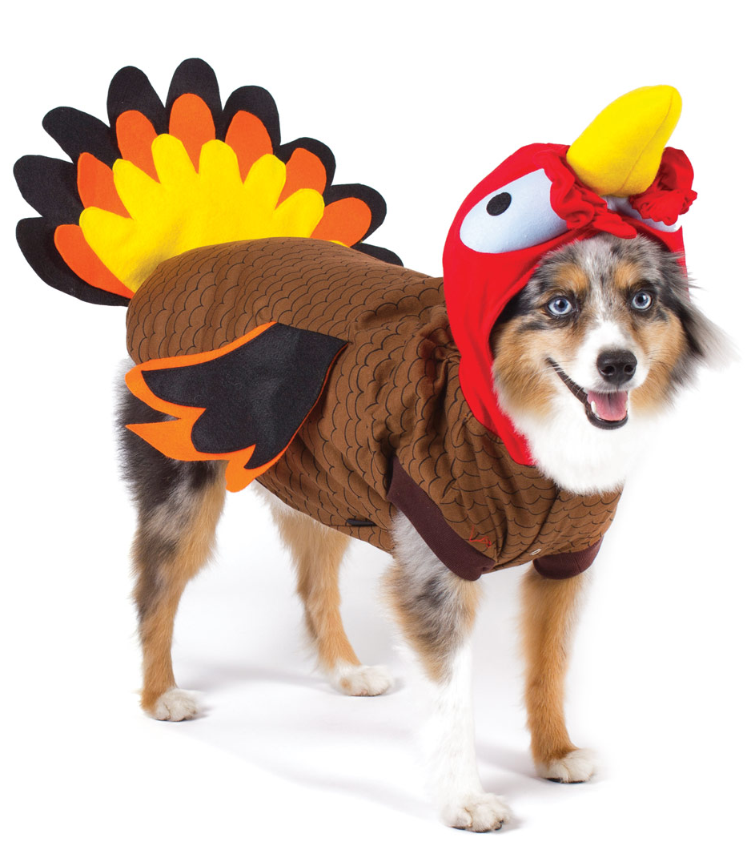
Have a Happy Thanksgiving!

